Slide 1

Medical Report Generation
Members:
Nada Mohamed Mohamed Hassan
Hadeel Osama Abdullah Abbar
Nouran Sayed Nasr Ibrahim
Manar Mahmoud Ahmed
Hagar Ahmed Mahmoud
Supervised by:
Prof .Dr. Abeer Mahmoud
TA. Yomna Ahmed

Slide 2


Introduction
Medical imaging plays a significant role in the diagnosis and treatment of diseases.
Computer-aided diagnosis and medical imaging systems have improved in the past decade to a point where they can partially mimic radiologists.
The most common medical imaging application is the Chest X-Ray.

Slide 3
Problem definition
Huge number of medical images and limited number of radiologists.
Reports are long and contain multiple sentences.
Directly applying image captioning on medical images will cause:
Visual data bias.
Textual data bias.

Slide 4
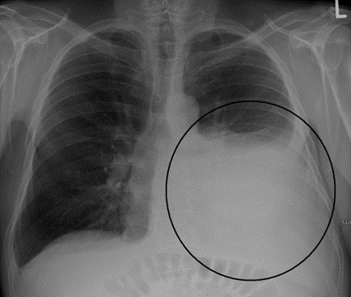
Motivation
Help to reduce workload of radiologists in writing medical reports.
Helping radiologists to capture abnormal regions to describe normal and abnormal diagnoses.
Study recent deep learning models for report generation.

Slide 5
Objective
Create an application that helps physicians to generate reports from medical images.
Insert chest x-ray as an input to the application, then generate a report automatically.
We aimed to achieve this by: surveying the related works, selecting the most recent and efficient technique and comparing its performance with others.

Slide 6
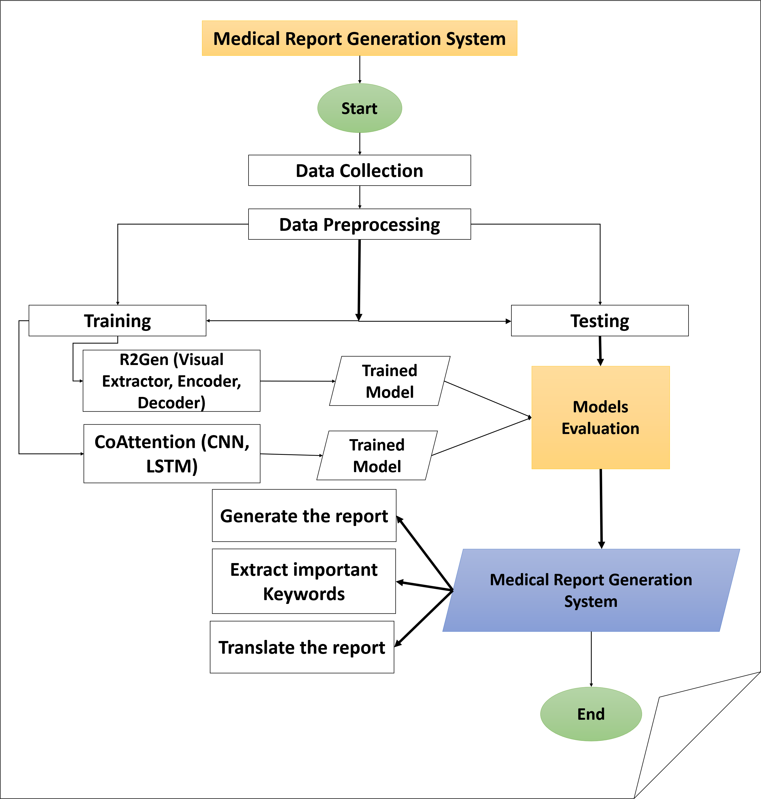
Project Phases

Slide 7
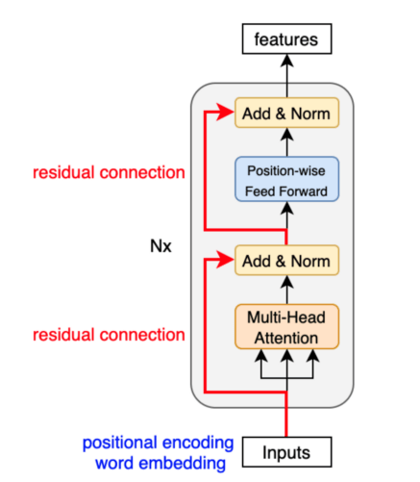
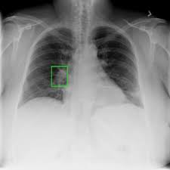
Encoder
Standard encoder from transformer
Input: features extracted by visual extractor.
Output: Hidden states encoded from input features.
Consists of two main parts
Multi-head Attention.
Feed Forward layer.

Slide 8
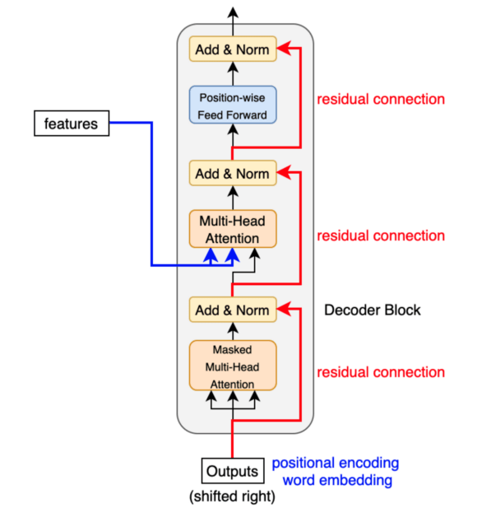
Decoder
Standard decoder from transformer
Input: previous output from decoder, hidden features extracted from encoder.
Output: subsequent input to the decoder.
Consists of three main parts
Masked Multi-head Attention.
Multi-head Attention.
Positional-wise Feed Forward layer.

Slide 9
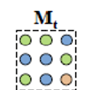
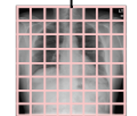
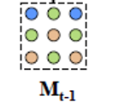
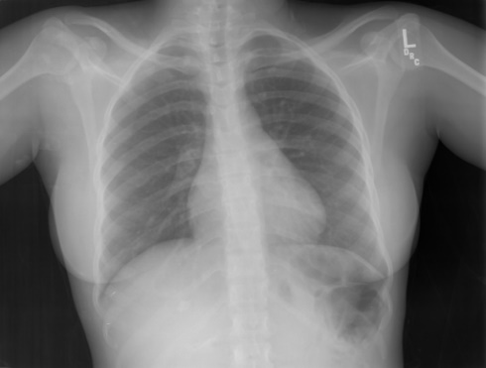
R2Gen Architecture
Output
Softmax
Linear
Decoder
Encoder layer
Memory-driven conditional layer
Feed Forward
Extend
Patch
features
Memory-driven conditional layer
Relational Memory
Multi-Head Attention
Visual extractor
Memory-driven conditional layer
Masked Multi-Head Attention
Output Embedding

Slide 10
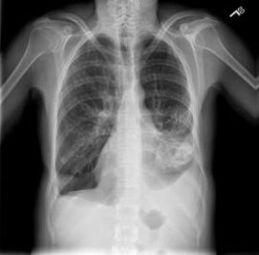
Dataset
IU-X-ray:
Public dataset contains 3,955 radiology reports and 7,470 X-rays images.
Report:
The heart is within normal limits in size. Surgical suture material projects over the right lung apex. The lungs are hyperlucent and hyperinflated compatible with emphysema. There is left lower lobe airspace disease identified. There is moderate left pleural effusion and small right pleural effusion. No visualized pneumothorax.
MIMIC-CXR
The largest radiology dataset to date that consists of 473,057 chest X-ray images and 206,563 reports from 63,478 patients.

Slide 11
Preprocessing
Image preprocessing
Resize the input images, crop them, horizontally flip them randomly, transform them to tensors, and normalize a tensor image with mean and standard deviation.
After that, convert the image to RGB.
Report preprocessing
The report is cleaned and then tokenized by breaking it down into words, then counting the repetition of each word and considering only the words that are repeated over a certain threshold; these words are sorted alphabetically, and each word is given an index forming a list of vocab.

Slide 12
Medical Report Generation
We train R2gen model on 5,226 images , 2,770 report.
Number of epochs = 50
Batch size = 16
The model is trained under cross entropy loss with ADAM optimizer.
Train
TEST
Test with 1,496 Images, 790 report.
Calculate loss and apply different evaluation metrics.

Slide 13
Experiments and Results (Experiment 1: R2Gen Visual Extractor)
We trained the model using the two visual extractors ResNet101 and vgg19, and we observed that the visual extractor ResNet101 gives higher accuracy and lower testing time per image.
Visual Extractor | BL-1 | BL-2 | BL-3 | BL-4 | MTR | RG-L | Testing time for one image (sec)
ResNet101 | 0.44 | 0.29 | 0.21 | 0.16 | 0.18 | 0.36 | 13.6
Vgg19 | 0.43 | 0.27 | 0.19 | 0.14 | 0.17 | 0.34 | 17.4

Slide 14
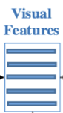
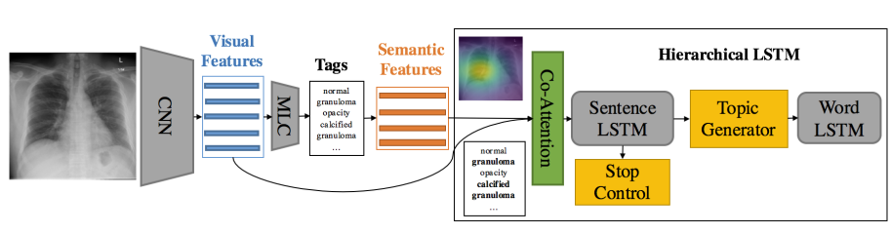
Experiments and Results cont. (Experiment 2: Comparison with Co-attention)
Co-Attention Model is based on “CNN-LSTM”.
R2Gen Model is based on transformer.
CNN
LSTM
Report
Co-Attention

Slide 15
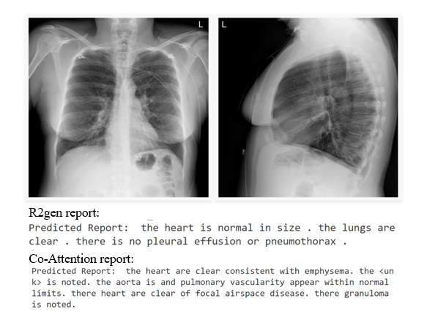
Experiments and Results cont.
Both models (R2gen and Co-Attention) are trained with 50 epochs and then, tested with 100 images to calculate average time on one image and metrices.
Model | R2gen | Co-Attention
BL-1 | 0.25 | 0.20
Avg testing time for one image (sec). | 12.5 | 4.6

Slide 16
Additional Features
Several features were added for the generated medical report analysis. These features include:
Keyword Extraction
Translation into Arabic.

Slide 17
Additional Features (cont.)
Keyword Extraction:
We identified the most significant medical keywords using the NLP algorithm TextRank using Natural Language Toolkit (NLTK) with some improvements.
- The following steps are applied:
Tokenization.
Text Cleaning, Stop Words Removal.
Word Frequency Calculation.
Building a graph of words using TextRank.
Sorting the words by their TextRank score.
Extracting the top words.
Finally, some improvements were made using important chest X-ray keywords.

Slide 18
Additional Features (cont.)
Translation:
- We used APIs such as the “My Memory and Reverso Context” Websites.
- The user of our system can select between 2 options:
Translate full report into Arabic.
Translate each word of the important keywords.

Slide 19
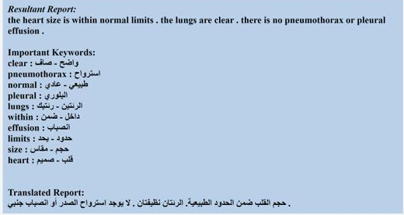
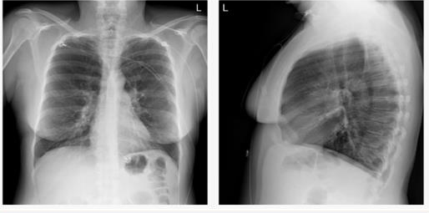
Additional Features: (Output)

Slide 20






Software Used
Python
HTML, CSS, jQuery to build our website.
Flask to deploy R2Gen model on website.
Natural Language Toolkit.

Slide 21
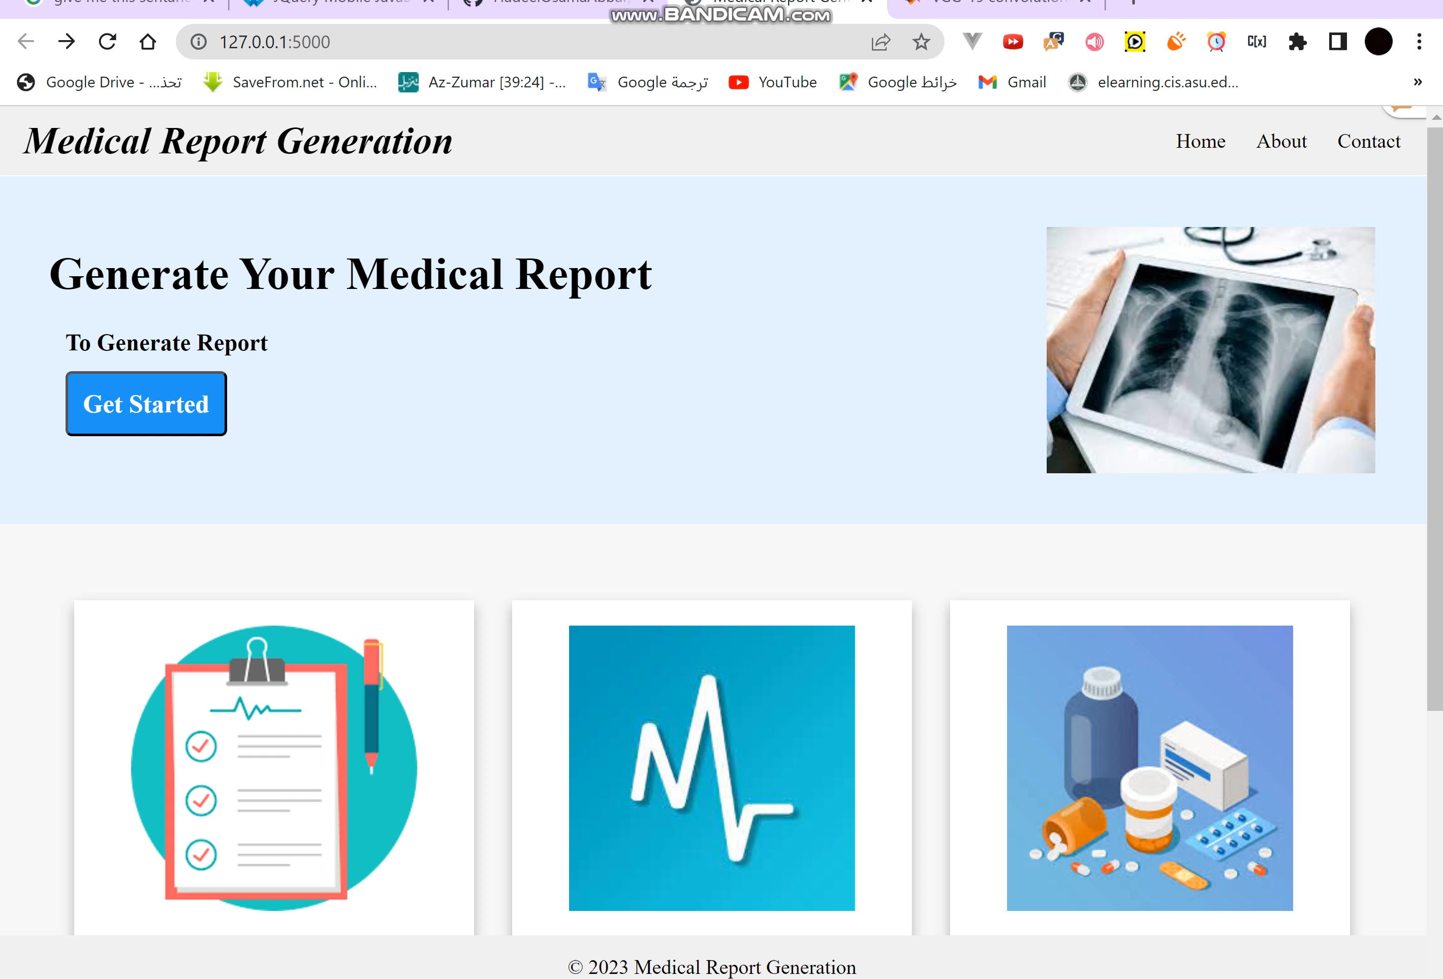
Demo Our resultant website

Slide 22
Conclusion
A medical report generation system is used to help radiologists to generate reports to diagnose patients automatically.
Our system generates radiology reports from medical images using R2Gen Model which is a transformer-based model with extra relational memory and MCLN to enhance the generated report.
We used NLP techniques to determine essential and medical keywords in the report to help patients and also translate the generated report into Arabic.

Slide 23
Conclusion (cont.)
We experimented with different models for automated medical report generation, these models are: R2Gen based on transformer and Co-Attention based on CNN-LSTM. Also, R2Gen model takes 2 images (lateral and frontal) as input while Co-Attention takes only one image.
We conclude that R2Gen is better than Co-Attention for the generated report, but Co-Attention is faster than R2Gen.
In addition, we tried to speed up R2Gen using VGG19 as a visual extractor, we conclude that visual extractor with ResNet101 is faster and more accurate than visual extractor VGG19.

Slide 24
Future work
The patient receives the report as a standard report that contains information about his/her medical history, physical examination findings, diagnostic test results.
Use another dataset, not chest X-ray; any medical data set, such as brain X-ray.

Slide 25
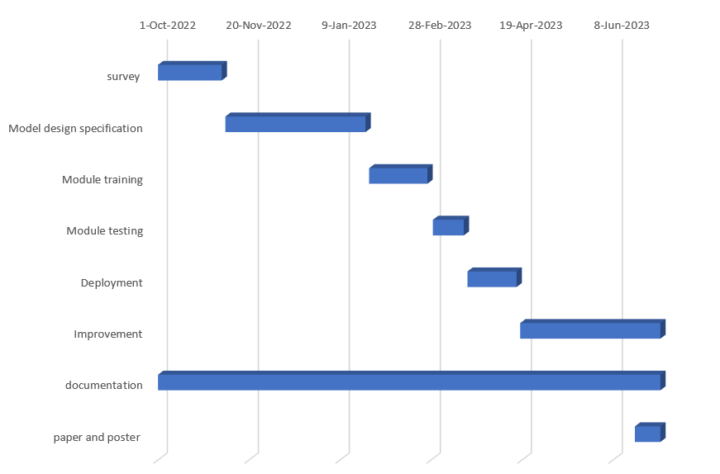
Time Plan

Slide 26
References
[1] Kelvin Xu, Jimmy Ba, Ryan Kiros, Kyunghyun Cho, Aaron Courville, Ruslan Salakhudinov, Rich Zemel, and Yoshua Bengio., 2015. Show, attend and tell: Neural image caption generation with visual attention.
[2] Chen, Z., Song, Y., Chang, T.H. and Wan, X., 2020. Generating radiology reports via memory-driven transformer. arXiv preprint arXiv:2010.16056.
[3] Sai, Rahul & Kather, Sharmila & Tripathy, B.K.. (2021). Automated Medical Report Generation on Chest X-Ray Images using Co-Attention mechanism.10.13140/RG.2.2.26061.15843.
[4] Vaswani, A., Shazeer, N., Parmar, N., Uszkoreit, J., Jones, L., Gomez, A.N., Kaiser, Ł. and Polosukhin, I., 2017. Attention is all you need. Advances in neural information processing systems, 30.
[5] https://kikaben.com/transformers-encoder-decoder

Slide 27


THANK YOU

Slide 28

System as Black Box
Visual Extractor
Encoder
Generated Report
Decoder
Relational Memory
Ground-truth: In comparison with study of there is again enlargement of the cardiac silhouette with a pacer device in place. No definite vascular congestion raising the possibility of underlying cardiomyopathy or pleural effusion. No acute focal pneumonia. The right picc line has been removed.

Slide 29
Medical Report Generation
We deployed R2gen on website using Flask:
Upload 2 images, then report is generated.
Deployment
Get the generated report, then extract important keywords and translate the report.

Slide 30
BLEU-n:
BLEU (bilingual evaluation understudy) is an algorithm for evaluating the quality of text that is the correspondence between a machine's output and that of a human.
BLEU's output is always a number between 0 and 1.
BLEU compares the n-gram of the candidate translation with n-gram of the reference translation to count the number of matches.

Slide 31
Related Work
Paper Name | Methods | Year | Dataset | Performance (BL-1)
Automated Medical Report Generation on Chest X-Ray Images | CNN Hierarchical LSTMs Co-Attention mechanism | 2021 | CXR (chest X-ray) | 0.213
CoAttention | CNN MLC Co-Attention. LSTM | 2018 | UI X-Ray PEIR Gross | IU X-Ray: 0.517 | PEIR Gross: 0.300

Slide 32
Related Work
Paper Name | Methods | Year | Dataset | Performance (BL-1)
Contrastive Attention (CA) | CNN. Aggregate Attention, Differentiate Attention. Hierarchical LSTM | 2021 | IU-X-ray MIMIC-CXR | IU-X-ray: 0.452 | MIMIC-CXR: 0.350
R2gen | Visual extractor(CNN) Encoder (transformer) Decoder (RM-MCLN) | 2020 | IU X-Ray MIMIC-CXR | IU X-Ray: 0.470 | MIMIC-CXR: 0.353

